Slide 1
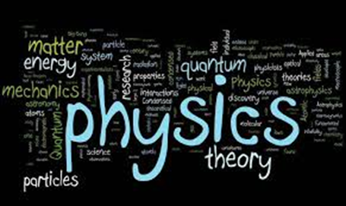
For the love of physics
Dr. Nameeqa Firdous
Notes:
What is Physics and why do we study it?

Slide 2
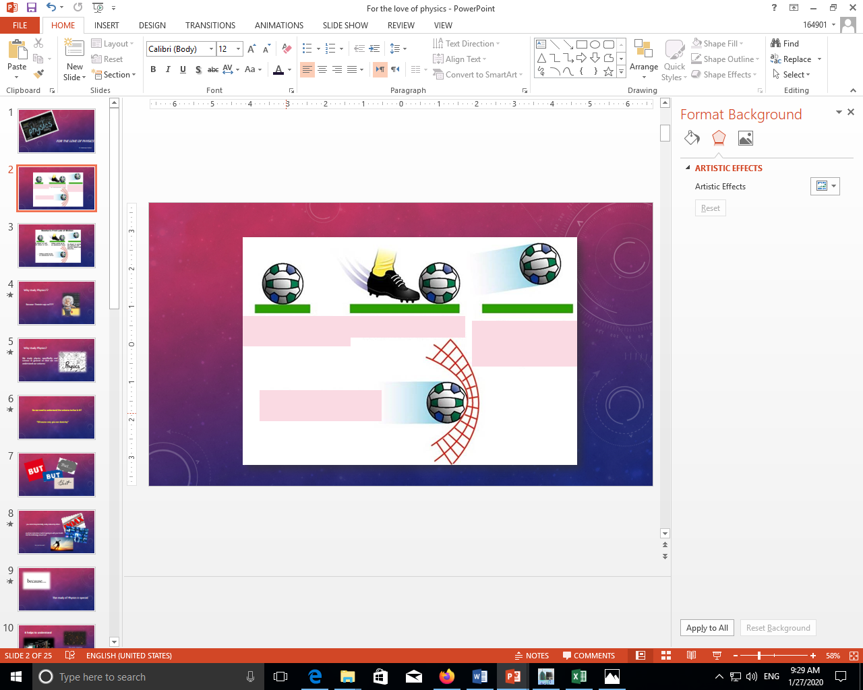

Slide 3
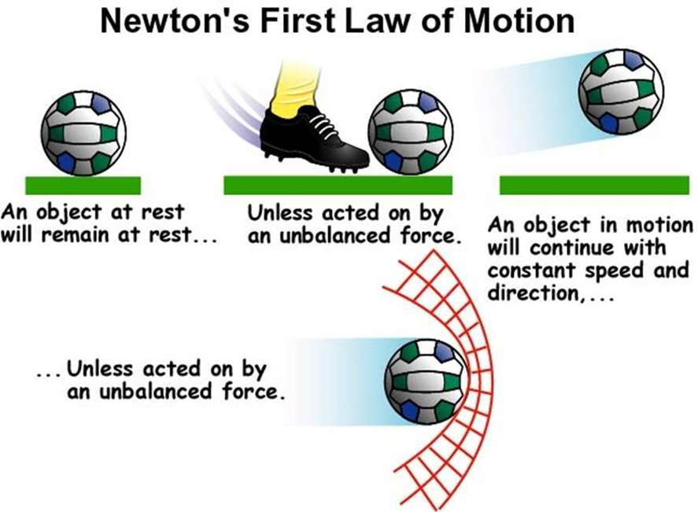
An object at rest will remain at rest
Unless acted on by a force
A moving object will continue with…….
Unless acted on by a force……

Slide 4
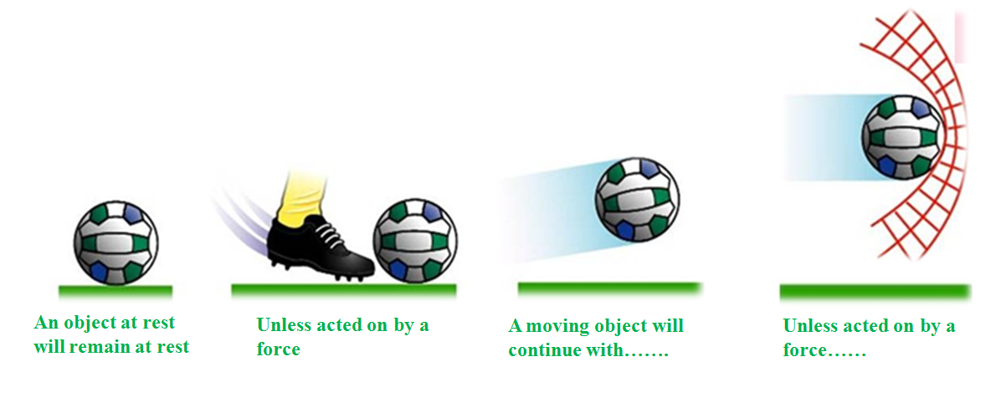

Slide 5
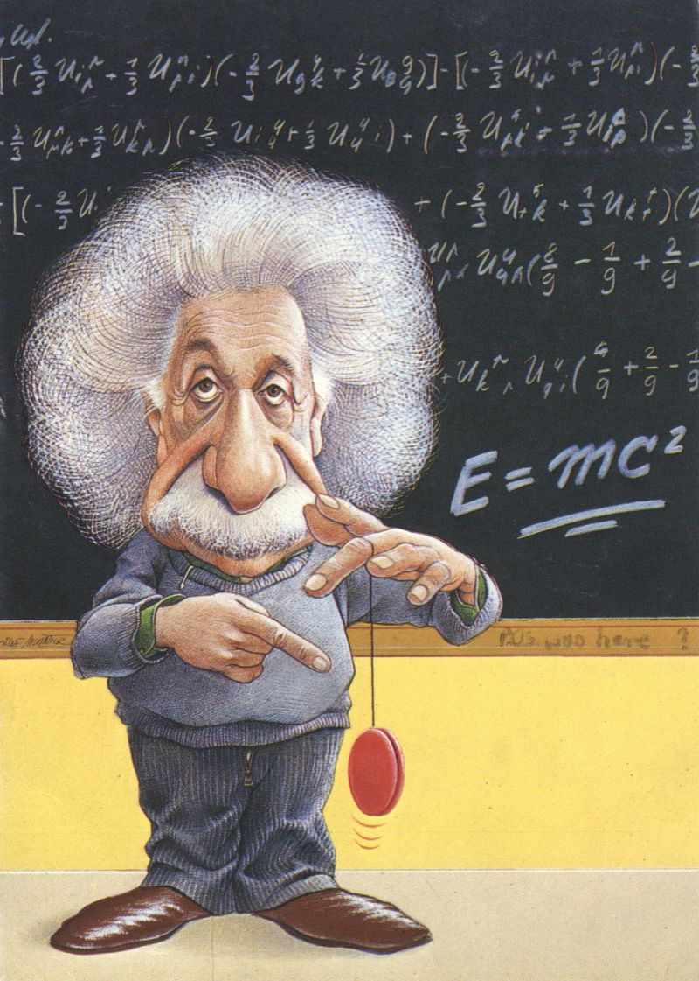
Why study Physics??
Because Einstein says so????

Slide 6
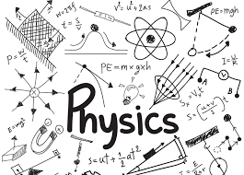
Why study Physics?
We study physics specifically and science in general so that we can understand our universe

Slide 7
Do we need to understand the universe to live in it?
“Of course not, you can skate by”

Slide 8





Slide 9



you cannot be potentially, easily mislead by others
you have some idea of what is going on with your health and the technology around you
You can live well
Notes:
You should strive for basic literacy in science so that

Slide 10

The study of Physics is special

Slide 11

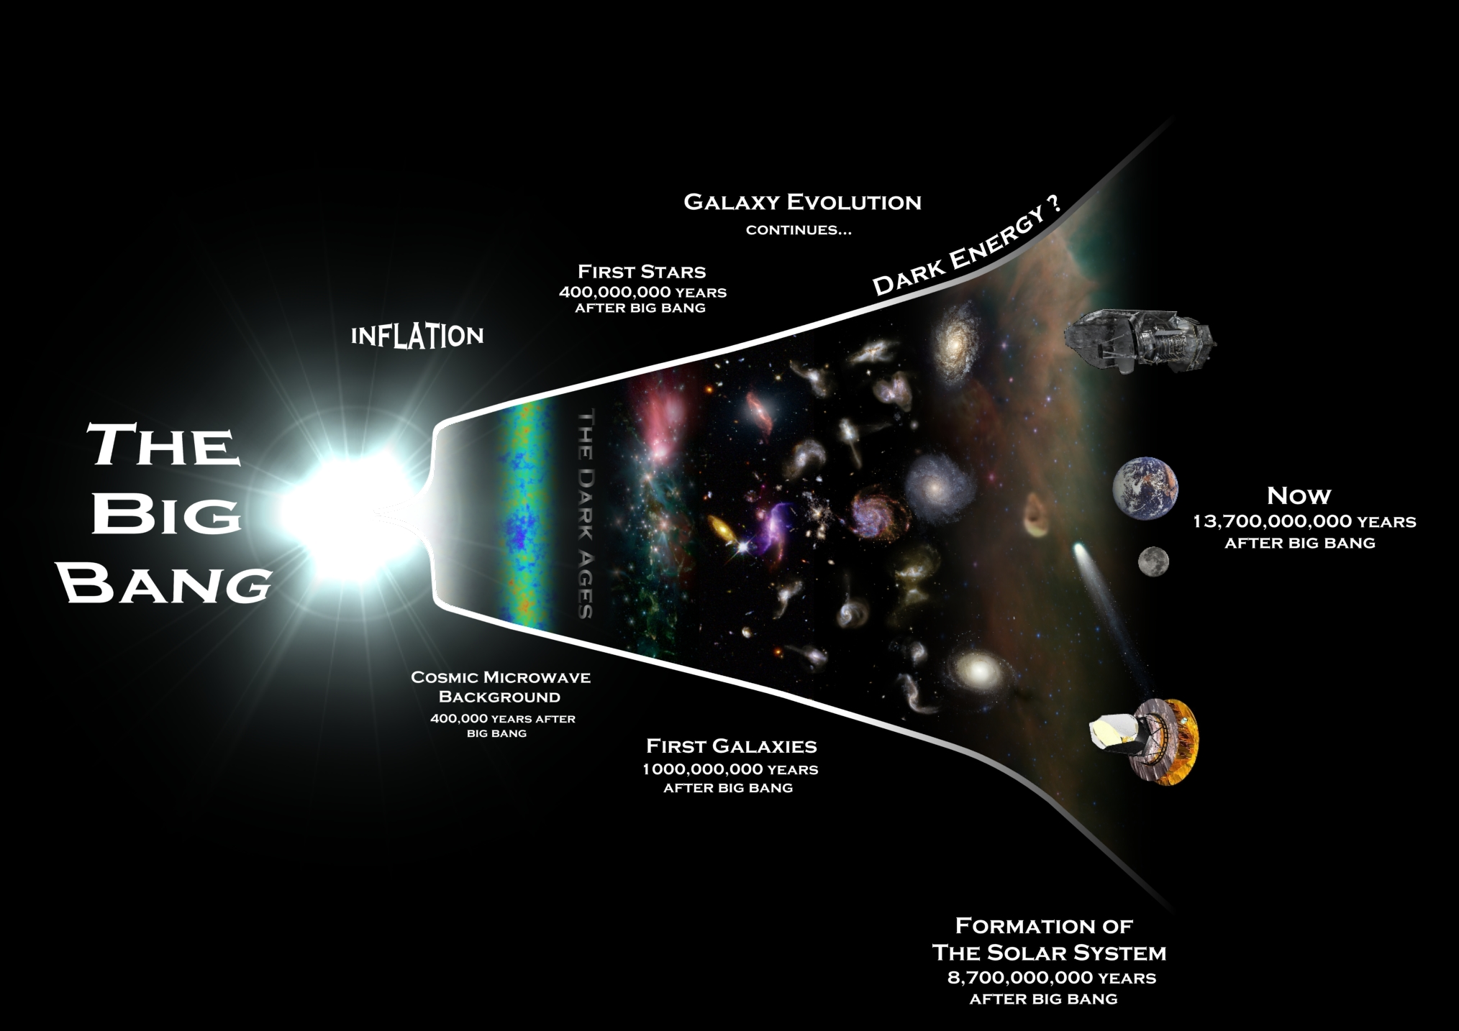

It helps to understand
… galaxies
Our universe
…. everyday encounters
Notes:
This is the picture taken by the Hubble Space Telescope showing thousands of galaxies. Even the tiny dots are whole galaxies. The universe is a very big place! how fundamental laws govern

Slide 12
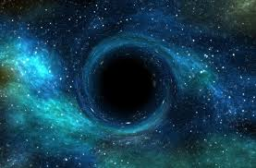
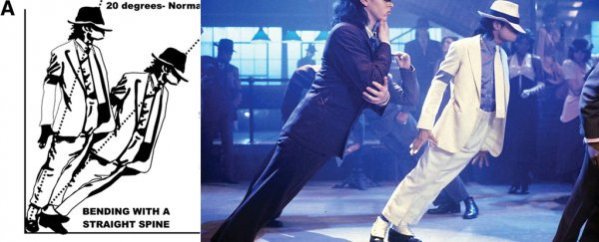
Possible or Impossible
and what is impossible - like defying gravity
Physics informs us of what is possible - from communicating by cell phones to predicting the growth of black holes
Notes:
This is the picture taken by the Hubble Space Telescope showing thousands of galaxies. Even the tiny dots are whole galaxies. The universe is a very big place!

Slide 13

Problem solver
Many Chief Technology Officers at top industries across the world have physics education & training, Physicists are problem solver!
It emphasizes how to solve problems.
Advances in physics allow scientists and engineers to formulate new technologies and initiate new industries.
This in turn drives economic growth and leads to a better tomorrow for society.
Notes:
This is the picture taken by the Hubble Space Telescope showing thousands of galaxies. Even the tiny dots are whole galaxies. The universe is a very big place!

Slide 14
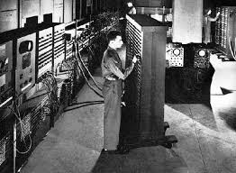
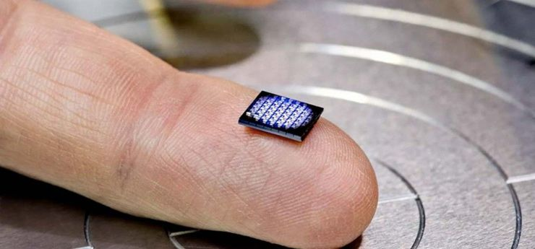
Physics in everyday life
World’s First Computer: 17,468 vacuum tubes, 70,000 resistors, 10,000 capacitors, 1,500 relays, and 6,000 manual switches !
Physics Research in Magnetic Materials, thin films and semiconductors led to small affordable computers
Notes:
Eniac (1945) :

Slide 15


Physics Revolutionizes Communication
WWW invented purely for Particle Physics Research !

Slide 16
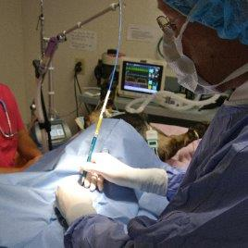
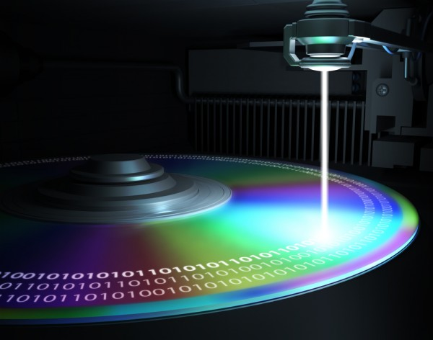

Lasers

Slide 17
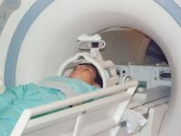
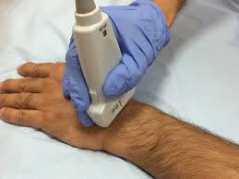
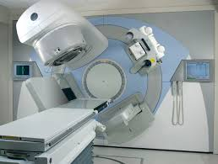
Medicine

Slide 18


Slide 19
Amazing facts….

Slide 20


Colors
Black can be defined as the visual impression experienced when no visible light reaches the eye. Pigments or dyes that absorb light rather than reflect it back to the eye "look black". A black pigment can, however, result from a combination of several pigments that collectively absorb all colors.

Slide 21

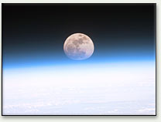
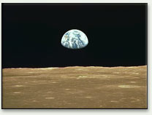
Color of Sky

Slide 22
Source of satisfaction: Money or Knowledge?
Need money
For Pizza, Smart Phone ……
Need Knowledge
Challenge of discovering how nature behaves
Springs you out of bed in the morning. A new day may mean a new discovery
An education in physics provides you with these twin necessities of life (money and knowledge of the nature)
To discover nature’s secrets is a thrill no money can ever buy !
This is why some of the smartest people do science

Slide 23
Career option
Science degree that gives students wide career options:
Research in all Physical sciences
Engineering and Material research (next slide)
Computation and Information Technology (First digital computer designed and built by physicists!)
Education : School, Colleges and universities
Pakistan Atomic Energy Commission (PAEC), PINTECH, NESCOM, SPARCO etc.
Journalism
Medical (Radiation related all PAEC centers)
Investment Banking
Future market modeling
And many more

Slide 24
Career Branches in Physics
Astrophysics
Material Science/ Solid State Physics
Medical Physics
Nuclear Physics
Theoretical/ Experimental Physics/ Computational Physics
High Energy Physics
Applied Physics/Optics/ Nanotechnology
Biophysics
Engineering

Slide 25
Why do we need more students to study physics?
We are not producing enough scientists and engineers
Our future economic prosperity will depend on a technologically literate workforce
Our Citizens need to be technologically literate to take an active part in today’s society
Scientific and technological progress requires a constant supply of new creative talent to push the envelope
And,
because the physical universe is so amazing

Slide 26



